Slide 1


Title:- “ Lost and Found Platform”
Shubda [1AJ23CS147]
Sindhu M [1AJ23CS152]
Sushmitha [1AJ23CS164]
Vijayalaxmi [1AJ23CS181]
Presented by:
Guided By:-Prof. Gopala Krishna
Department of Computer Science and Engineering
www.cambridge.edu.in

Slide 2

CONTENTS:
Introduction
Abstract
Problem Statement
System Specifications
Hardware Requirements
Software Requirements
Tools & Technologies used in Web applications
Flow chart & ER diagram
Department of Computer Science and Engineering
www.cambridge.edu.in

Slide 3
INTRODUCTION
In today’s fast-paced world, losing personal belongings in public places is a common problem faced by many. Whether it’s a misplaced phone, a forgotten bag, or a lost ID card, recovering these items often becomes a stressful and time-consuming process. To address this issue, we propose a Lost and Found platform—a centralized, user-friendly system designed to connect individuals who have lost items with those who have found them. This platform allows users to report lost items by providing relevant details and images, and similarly, enables others to report found items. Using search filters and intelligent matching, the system helps increase the chances of reuniting items with their rightful owners. The platform can be implemented in institutions, public transport systems, or community areas. Our goal is to simplify the process of returning lost belongings, promote honesty, and create a helpful community-driven solution for everyday life challenges.
Department of Computer Science and Engineering
www.cambridge.edu.in

Slide 4
Abstract
Losing personal belongings is a common issue faced by people in public places, educational institutions, and workplaces. Retrieving these lost items can often be time-consuming, frustrating, and sometimes unsuccessful. To address this problem, the Lost and Found platform is developed as a digital solution that helps users report and search for lost or found items efficiently. This platform allows users to upload details and images of lost or found belongings, creating a centralized database accessible to all registered users. By leveraging intelligent search and filtering options, the system facilitates quicker and more accurate matching between lost and found reports, improving the chances of reuniting items with their rightful owners. The platform aims to simplify the reporting process, reduce manual searching efforts, and promote honesty among users by encouraging responsible behavior. Additionally, it provides accessibility across multiple devices, ensuring users can report or search for items anytime and anywhere. By creating a trustworthy and organized system, the Lost and Found platform enhances community cooperation and supports users in recovering their belongings efficiently, ultimately reducing the stress and inconvenience associated with lost items.
Department of Computer Science and Engineering
www.cambridge.edu.in

Slide 5
Problem Statement
Losing personal belongings such as wallets, phones, or ID cards in public places is a frequent problem that causes inconvenience, stress, and sometimes financial loss. Traditional methods of reporting lost and found items often involve manual processes, scattered records, or physical notice boards, which are inefficient and slow. Many times, lost items remain unrecovered due to lack of proper communication channels between the person who lost the item and the person who found it. This results in frustration for both parties and a low recovery rate of lost belongings. Moreover, the absence of a centralized system leads to confusion, duplication of efforts, and difficulty in tracking lost or found items. There is a clear need for a digital solution that can simplify and streamline the reporting and searching process, enhance communication, and improve the chances of recovering lost items quickly and efficiently. The Lost and Found platform aims to address these challenges by providing an organized and user-friendly online system.
Department of Computer Science and Engineering
www.cambridge.edu.in

Slide 6
System Specifications
Backend Tools
Frontend Tools
Node.js(JavaScript)
Python(using Flask or Django)
Java(using Spring Boot)
PHP(Laravel)
Ruby(Ruby on Rails)
HTML5(Structure of web pages)
CSS3(Styling or Layout)
JavaScript(Interactive Functionally)
Department of Computer Science and Engineering
www.cambridge.edu.in

Slide 7
Hardware Requirements
Device Name: Any modern PC/Laptop(eg: Dell Inspiron, HP Pavilion)
Processor(CPU): Dual-Core 2.0 GHz+(Intel i3/AMD equivalent)
Installed RAM: 4GB
Storage: 256GB HDD/SSD
Graphics Card: Integrated GPU(Intel UHD/AMD Vega)
Department of Computer Science and Engineering
www.cambridge.edu.in

Slide 8
Software Requirements
Operating System: Windows/Linux/macOS, Android/iOS
Web Server: Apache,Node.js Express Server
Database Server: MYSQL/PostgreSQL/MongoDB
IDE/Text Editor: Visual Studio Code, IntelliJ IDEA/Eclipse, PyCharm
Browser: Google Chrome, Mozilla Firefox, Microsoft Edge(for testing and usage)
Department of Computer Science and Engineering
www.cambridge.edu.in

Slide 9
Tools & Technologies Used-Web Applications
Programming Languages: HTML, CSS, JavaScript, Python/Java/PHP/Node.js
Frameworks: React/Angular (Frontend),Django/Laravel(Backend),Bootstrap/Tailwind CSS(UI)
Development Tools: Visual Studio Code, GitHub, Postman, Jira
Database: MySQL/PostgreSQL
Payment Gateway: PayPal, Stripe, Razor pay
Department of Computer Science and Engineering
www.cambridge.edu.in

Slide 10
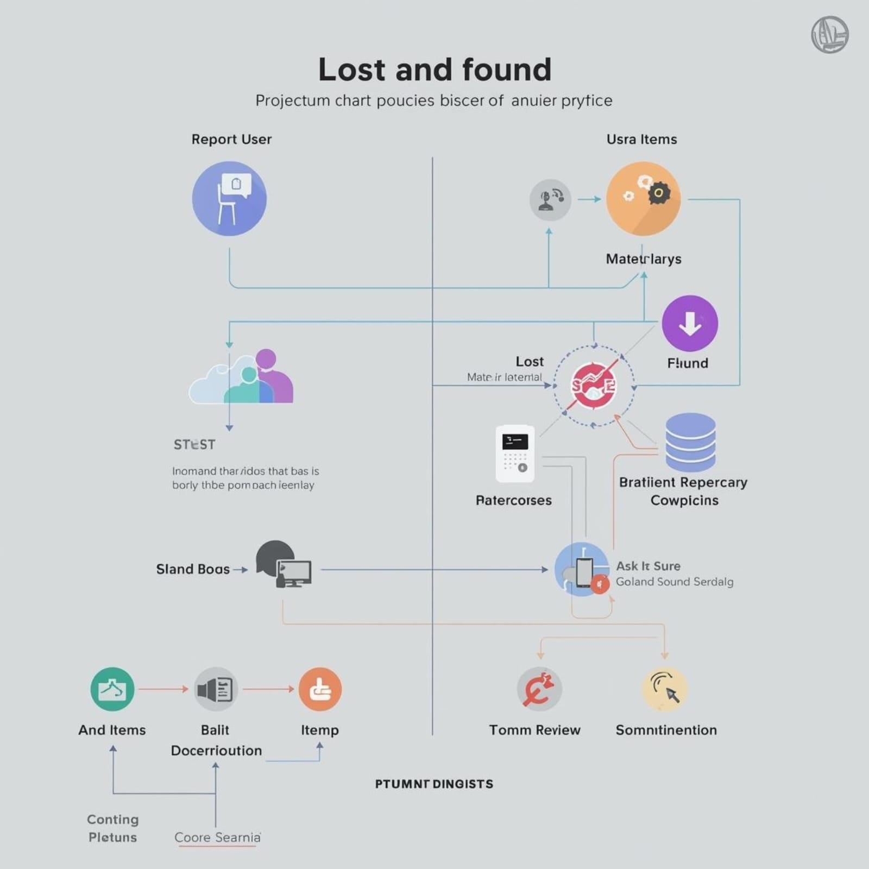
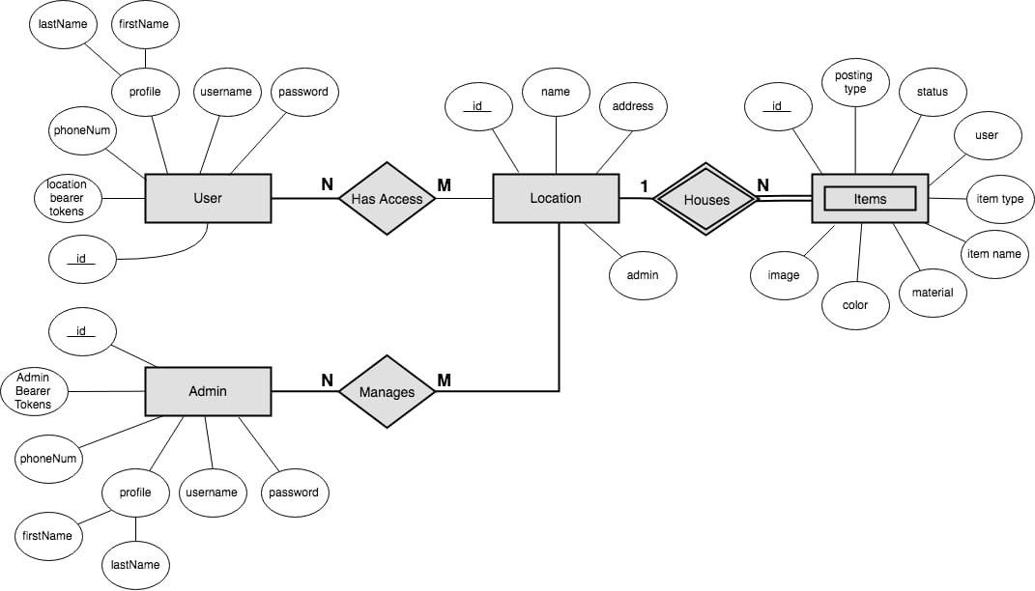
Flow Chart
ER Diagram
Department of Computer Science and Engineering
www.cambridge.edu.in

Slide 11
THANK YOU
Department of Computer Science and Engineering
www.cambridge.edu.in

